Slide 1
Employee Data Analysis using Excel
STUDENT NAME:Seetha.B
REGISTER NO:D2653C8889585C7B462473E724C7582B
DEPARTMENT: Commerce
COLLEGE: Bharathi Women's college

Slide 2
PROJECT TITLE
EMPLOYEE SALARY ANALYSIS

Slide 3


AGENDA
Problem Statement
Project Overview
End Users
Our Solution and Proposition
Dataset Description
Modelling Approach
Results and Discussion
Conclusion
3/21/2024 Annual Review

Slide 4

PROBLEM STATEMENT
The goal is to analyze employee salary data to identify patterns, trends, and disparities. This involves evaluating salary distribution across various departments, job roles, and experience levels. The analysis should highlight any significant disparities, help in understanding compensation structures, and inform decisions for equitable salary adjustments and budgeting.

Slide 5

PROJECT OVERVIEW
A salary analysis, or compensation analysis, is a project that compares an organization's compensation packages to market rates to determine if salary adjustments are needed. It can also help ensure that compensation is fair and equitable across all roles.

Slide 6

WHO ARE THE END USERS?
1. HR Managers 2. Finance Teams 3. Executives 4. Employees 5. Compensation Analysts

Slide 7

OUR SOLUTION AND ITS VALUE PROPOSITION
Comprehensive salary analysis tool Value Proposition:Provides actionable insights into salary distribution, identifies disparities, and supports data-driven decisions for fair compensation and budget management.

Slide 8
Dataset Description
It includes employee details such as salaries, job titles, departments, experience levels, and demographics. The dataset allows for analysis of salary distribution, trends, and disparities across different categories.

Slide 9

THE "WOW" IN OUR SOLUTION
The WOW Factor Delivers clear, actionable insights into salary equity and trends, enabling precise adjustments and strategic planning to ensure fair and competitive compensation.
3/21/2024 Annual Review
9

Slide 10
MODELLING
Utilizes statistical and machine learning techniques to analyze salary data, identify patterns, forecast trends, and detect disparities. This helps in understanding compensation structures and making data-driven decisions for salary adjustments.
10

Slide 11
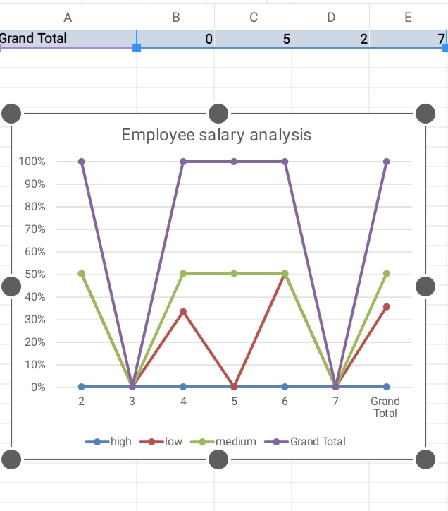
RESULTS
11

Slide 12
conclusion
The analysis reveals key insights into salary distribution, identifies areas of disparity, and supports informed decision-making for equitable compensation and effective budget management.

